Slide 1
Requirement Guild

Slide 2
基本理念
Principles that Guide Process – I
Principle #1. Be agile (簡潔). Whether the process model you choose is prescriptive or agile, the basic tenets of agile development should govern your approach.
Principle #2. Focus on quality at every step (品質). The exit condition for every process activity, action, and task should focus on the quality of the work product that has been produced.
Principle #3. Be ready to adapt. (彈性) Process is not a religious experience and dogma has no place in it. When necessary, adapt your approach to constraints imposed by the problem, the people, and the project itself.
Principle #4. Build an effective team. (團隊)Software engineering process and practice are important, but the bottom line is people. Build a self-organizing team that has mutual trust and respect.

Slide 3
Principles that Guide Process - II
Principle #5. Establish mechanisms for communication and coordination. (溝通) Projects fail because important information falls into the cracks and/or stakeholders fail to coordinate their efforts to create a successful end product.
Principle #6. Manage change. (改變) The approach may be either formal or informal, but mechanisms must be established to manage the way changes are requested, assessed, approved and implemented.
Principle #7. Assess risk. (風險) Lots of things can go wrong as software is being developed. It’s essential that you establish contingency plans.
Principle #8. Create work products that provide value for others. (價值) Create only those work products that provide value for other process activities, actions or tasks.

Slide 4
行動綱領
Principles that Action Practice- I
Principle #1. Divide and conquer. (化繁為簡) Stated in a more technical manner, analysis and design should always emphasize separation of concerns (SoC).
Principle #2. Understand the use of abstraction. (提綱挈領) At it core, an abstraction is a simplification of some complex element of a system used to communication meaning in a single phrase.
Principle #3. Strive for consistency. (一致性) A familiar context makes software easier to use.
Principle #4. Focus on the transfer of information. (界接介面) Pay special attention to the analysis, design, construction, and testing of interfaces.

Slide 5
Principles that Action Practice- II
Principle #5. Build software that exhibits effective modularity. (模組架構) Separation of concerns (Principle #1) establishes a philosophy for software. Modularity provides a mechanism for realizing the philosophy.
Principle #6. Look for patterns. (模式樣板) The goal of patterns within the software community is to create a body of literature to help software developers resolve recurring problems encountered throughout all of software development.
Principle #7. When possible, represent the problem and its solution from a number of different perspectives. (換位思考)
Principle #8. Remember that someone will maintain the software. (維護彈性)

Slide 6
Communication Principles
Principle #1. Listen. (聆聽) Try to focus on the speaker’s words, rather than formulating your response to those words.
Principle # 2. Prepare before you communicate. (事情準備) Spend the time to understand the problem before you meet with others.
Principle # 3. Someone should facilitate the activity. (決策者) (1)Every communication meeting should have a leader (a facilitator) to keep the conversation moving in a productive direction; (2) to mediate any conflict that does occur, and (3) to ensure than other principles are followed.
Principle #4. Face-to-face communication is best. (當面溝通) But it usually works better when some other representation of the relevant information is present.

Slide 7
Communication Principles
Principle # 5. Take notes and document decisions. (記錄) Someone participating in the communication should serve as a “recorder” and write down all important points and decisions.
Principle # 6. Strive for collaboration. (團隊合作) Collaboration and consensus occur when the collective knowledge of members of the team is combined …
Principle # 7. Stay focused, modularize your discussion. (專注聚焦) The more people involved in any communication, the more likely that discussion will bounce from one topic to the next.
Principle # 8. If something is unclear, draw a picture. (圖優於文)
Principle # 9. (a) Once you agree to something, move on; (b) If you can’t agree to something, move on; (c) If a feature or function is unclear and cannot be clarified at the moment, move on. (持續往前)
Principle # 10. Negotiation is not a contest or a game. It works best when both parties win. (妥協創造雙贏)

Slide 8
Planning Principles
Principle #1. Understand the scope of the project. (設立範圍) It’s impossible to use a roadmap if you don’t know where you’re going. Scope provides the software team with a destination.
Principle #2. Involve the customer in the planning activity. (客戶需求) The customer defines priorities and establishes project constraints.
Principle #3. Recognize that planning is iterative. (滾動式修正) A project plan is never engraved in stone. As work begins, it very likely that things will change.
Principle #4. Estimate based on what you know. (現況預測) The intent of estimation is to provide an indication of effort, cost, and task duration, based on the team’s current understanding of the work to be done.

Slide 9
Planning Principles
Principle #5. Consider risk as you define the plan. (考慮風險) If you have identified risks that have high impact and high probability, contingency planning is necessary.
Principle #6. Be realistic. (務實) People don’t work 100 percent of every day.
Principle #7. Adjust granularity as you define the plan. (逐步精細) Granularity refers to the level of detail that is introduced as a project plan is developed.
Principle #8. Define how you intend to ensure quality. (品質確保) The plan should identify how the software team intends to ensure quality.
Principle #9. Describe how you intend to accommodate change. (改變應對) Even the best planning can be obviated by uncontrolled change.
Principle #10. Track the plan frequently and make adjustments as required. (緊盯進度)

Slide 10
Modeling Principles (建模)
In software engineering work, two classes of models can be created:
  Requirements models (also called analysis models) represent the customer requirements by depicting the software in three different domains: the information domain, the functional domain, and the behavioral domain.
  Design models represent characteristics of the software that help practitioners to construct it effectively: the architecture, the user interface, and component-level detail.

Slide 11
Requirements Modeling Principles
Principle #1. The information domain of a problem must be represented and understood. (領域知識)
Principle #2. The functions that the software performs must be defined. (功能定義)
Principle #3. The behavior of the software as a consequence of external events) must be represented. (流程清楚)
Principle #4. The models that depict information, function, and behavior must be partitioned in a manner that uncovers detail in a layered (or hierarchical) fashion. (分層描述)
Principle #5. The analysis task should move from essential information toward implementation detail. (從基本推展到細節)

Slide 12
Requirements Engineering-I
#1 Inception (建立) —ask a set of questions that establish …
  basic understanding of the problem (問題或需求)
  the people who want a solution (對象)
  the nature of the solution that is desired (期望效果)
  the effectiveness of preliminary communication and collaboration between the customer and the developer (主客互動、協同合作)
#2 Elicitation (啟發)—elicit requirements from all stakeholders
#3 Elaboration (制定 )—create an analysis model that identifies data, function and behavioral requirements
#4 Negotiation (談判) —agree on a deliverable system that is realistic for developers and customers

Slide 13
Requirements Engineering-II
# 5 Specification (規格)—can be any one (or more) of the following:
  A written document
  A set of models
  A formal mathematical
  A collection of user scenarios (use-cases)
  A prototype
#6 Validation (驗證)—a review mechanism that looks for
  errors in content or interpretation
  areas where clarification may be required
  missing information
  inconsistencies (a major problem when large products or systems are engineered)
  conflicting or unrealistic (unachievable) requirements.
#7 Requirements management

Slide 14
Inception
Identify stakeholders (利益相關者)
  “who else do you think I should talk to?”
Recognize multiple points of view
Work toward collaboration
The first questions
  Who is behind the request for this work?
  Who will use the solution?
  What will be the economic benefit of a successful solution
  Is there another source for the solution that you need?

Slide 15
Eliciting Requirements
meetings are conducted and attended by both software engineers and customers
rules for preparation and participation are established an agenda is suggested
a "facilitator" (can be a customer, a developer, or an outsider) controls the meeting
a "definition mechanism" (can be work sheets, flip charts, or wall stickers or an electronic bulletin board, chat room or virtual forum) is used
the goal is
  to identify the problem
  propose elements of the solution
  negotiate different approaches, and
  specify a preliminary set of solution requirements

Slide 16
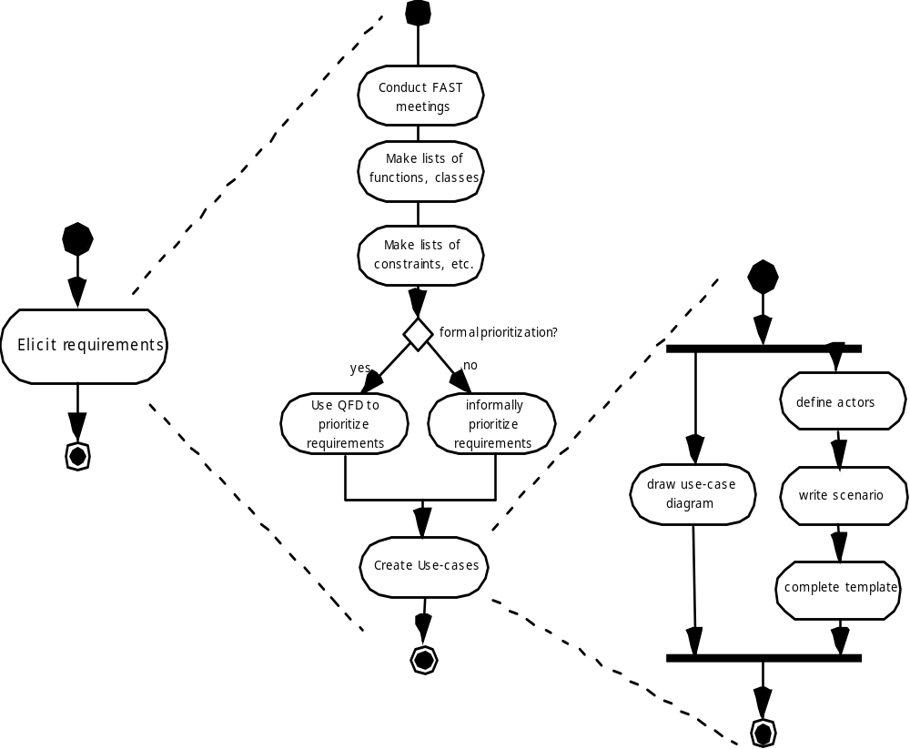
Eliciting Requirements

Slide 17
Quality Function Deployment
Function deployment determines the “value” (as perceived by the customer) of each function required of the system
Information deployment identifies data objects and events
Task deployment examines the behavior of the system
Value analysis determines the relative priority of requirements

Slide 18
Elicitation Work Products
a statement of need and feasibility.
a bounded statement of scope for the system or product.
a list of customers, users, and other stakeholders who participated in requirements elicitation
a description of the system’s technical environment.
a list of requirements (preferably organized by function) and the domain constraints that apply to each.
a set of usage scenarios that provide insight into the use of the system or product under different operating conditions.
any prototypes developed to better define requirements.

Slide 19
Building the Analysis Model
Elements of the analysis model
  Scenario-based elements
    Functional—processing narratives for software functions
    Use-case—descriptions of the interaction between an “actor” and the system
  Class-based elements
    Implied by scenarios
  Behavioral elements
    State diagram
  Flow-oriented elements
    Data flow diagram

Slide 20
Use-Cases
A collection of user scenarios that describe the thread of usage of a system
Each scenario is described from the point-of-view of an “actor”—a person or device that interacts with the software in some way
Each scenario answers the following questions:
  Who is the primary actor, the secondary actor (s)? (對象)
  What are the actor’s goals? (目的)
  What preconditions should exist before the story begins? (初始條件)
  What main tasks or functions are performed by the actor? (主要工作)
  What extensions might be considered as the story is described? (衍生擴充)
  What variations in the actor’s interaction are possible? (互動變化)
  What system information will the actor acquire, produce, or change? (資訊)
  Will the actor have to inform the system about changes in the external environment? (外在環境)
  What information does the actor desire from the system? (獲得資訊)

Slide 21
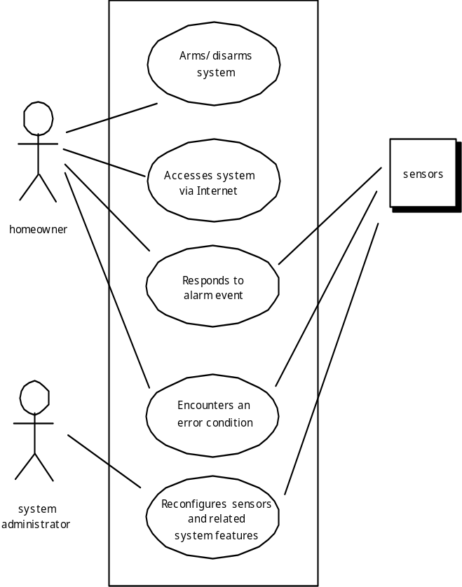
Use-Case Diagram

Slide 22
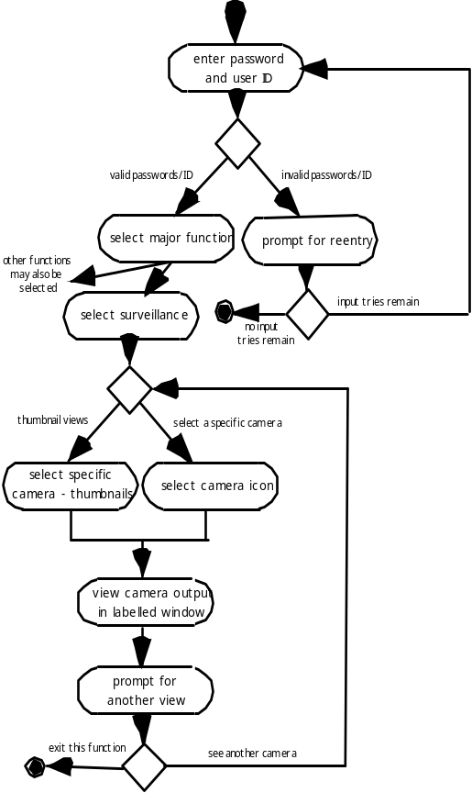
Activity Diagram
Supplements the use case by providing a graphical representation of the flow of interaction within a specific scenario

Slide 23
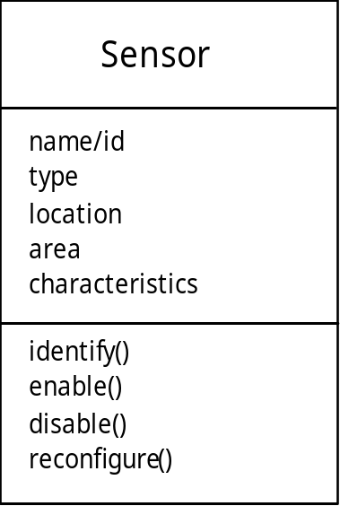
Class Diagram
From the SafeHome system …

Slide 24
The ERD: An Example
request
for service
Customer
places
(1,1)
(1,m)
(1,1)
standard
task table
(1,n)
work
order
generates
(1,1)
(1,1)
(1,1)
selected
from
work
tasks
(1,w)
(1,w)
consists
of
(1,i)
materials
lists

Slide 25
Negotiating Requirements
Identify the key stakeholders
  These are the people who will be involved in the negotiation
Determine each of the stakeholders “win conditions”
  Win conditions are not always obvious
Negotiate
  Work toward a set of requirements that lead to “win-win”

Slide 26
Validating Requirements
Is each requirement consistent with the overall objective for the system/product? (需求一致)
Have all requirements been specified at the proper level of abstraction? That is, do some requirements provide a level of technical detail that is inappropriate at this stage?
Is the requirement really necessary or does it represent an add-on feature that may not be essential to the objective of the system? (需求必須)
Is each requirement bounded and unambiguous? (定義明確)
Does each requirement have attribution? That is, is a source (generally, a specific individual) noted for each requirement? (來源可溯)
Do any requirements conflict with other requirements? (並免衝突)
Is each requirement achievable in the technical environment that will house the system or product? (技術可行)
Is each requirement testable, once implemented? (可被實現)

